Slide 1
Poetry 3 Eng 426
Fourth Year students
Basic and Special Education
Dr. Ebtihal Elshaikh

Slide 2
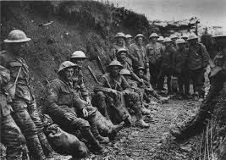
Anthem for doomed youth Wilfred Owen
Ironical title

Slide 3
WWI
Austria-Hungary/Germany/Italy
(Central Powers)
X
Britain/France/Russia
(Allied forces)
Irish War of Independence and Irish Civil War (1916- 1923)

Slide 4
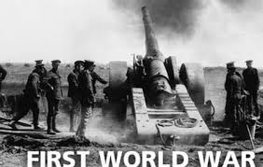
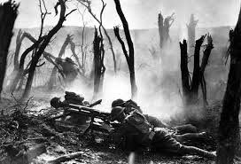
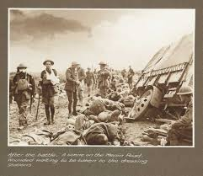

Slide 5
Onomatopoeia
Personification
Alliteration
What passing-bells for these who die as cattle?
Only the monstrous anger of the guns.
Only the stuttering rifles' rapid rattle
Can patter out their hasty orisons.

Slide 6
Oxymoron
No mockeries now for them; no prayers nor bells;
Nor any voice of mourning save the choirs, –
The shrill, demented choirs of wailing shells;
And bugles calling for them from sad shires.

Slide 7
Rhetorical questions
What candles may be held to speed them all?
Not in the hands of boys but in their eyes
Shall shine the holy glimmers of goodbyes.
The pallor of girls' brows shall be their pall;
Their flowers the tenderness of patient minds,
And each slow dusk a drawing-down of blinds.

Slide 8
Ambiguities and contradiction in language.
Ironical form

